Slide 1
Digital Logic & Design
Lecture 05
Notes:
Asalam O Aleikum students. I am Waseem Ikram.
This is the fifth lecture in a series of 45 lectures on Digital Logic Design.

Slide 2
Logic Gates
Basic Building Blocks
Logic Gate Symbol
Unique function
Truth or Function Table
Function Expression
Timing Diagram

Slide 3
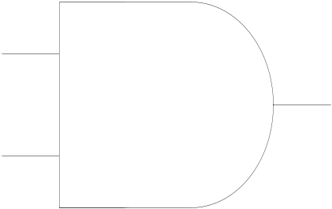
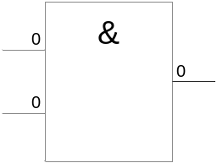
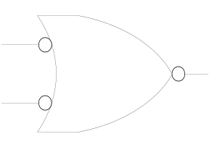
AND Gate
1 output
2 inputs
3 inputs
4 inputs
Multiple inputs

Slide 4


AND Gate function
Logical Multiplication function
Input |  | Output
A | B | F
0 | 0 | 0
0 | 1 | 0
1 | 0 | 0
1 | 1 | 1

Slide 5
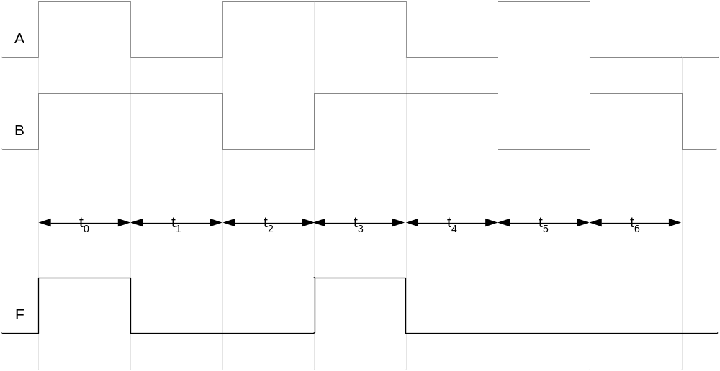
AND Gate Timing Diagram

Slide 6
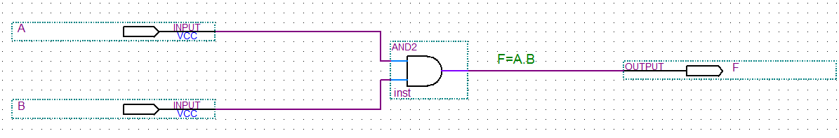
AND Gate function

Slide 7
AND Gate Timing Diagram

Slide 8
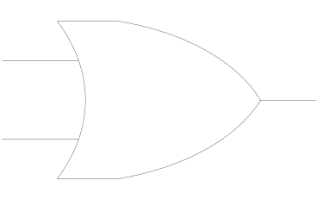
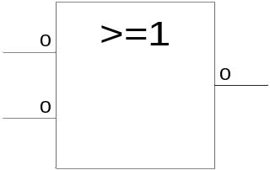
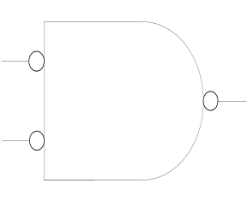
OR Gate
1 output
2 inputs
3 inputs
4 inputs
Multiple inputs

Slide 9

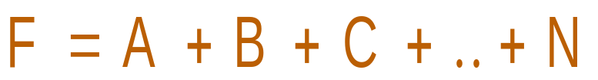
OR Gate function
Boolean Add function
Input |  | Output
A | B | F
0 | 0 | 0
0 | 1 | 1
1 | 0 | 1
1 | 1 | 1

Slide 10
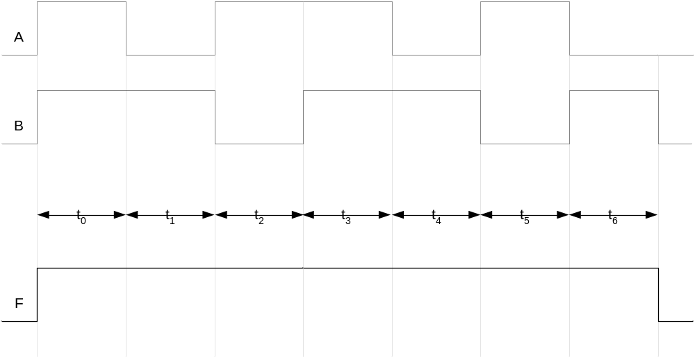
OR Gate Timing Diagram

Slide 11
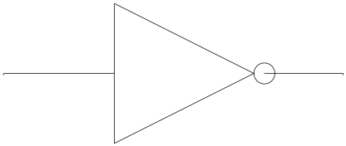
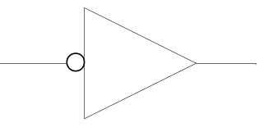
NOT Gate
1 input
1 output

Slide 12
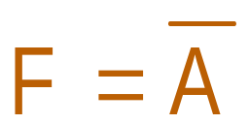
NOT Gate function
Invert function
Input | Output
A | F
0 | 1
1 | 0

Slide 13
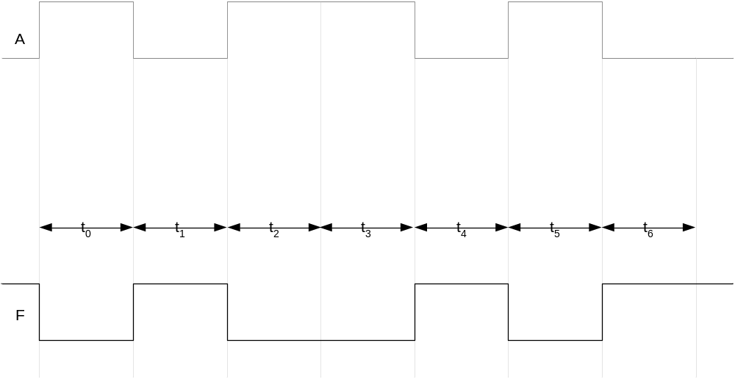
NOT Gate Timing Diagram

Slide 14
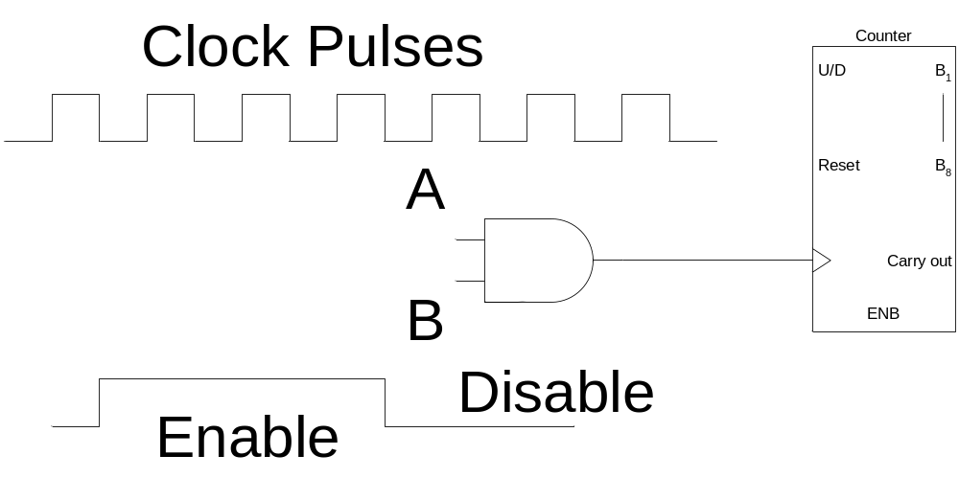
AND Gate Applications
Enable/Disable Device
  Counter counts when it receives pulses

Slide 15
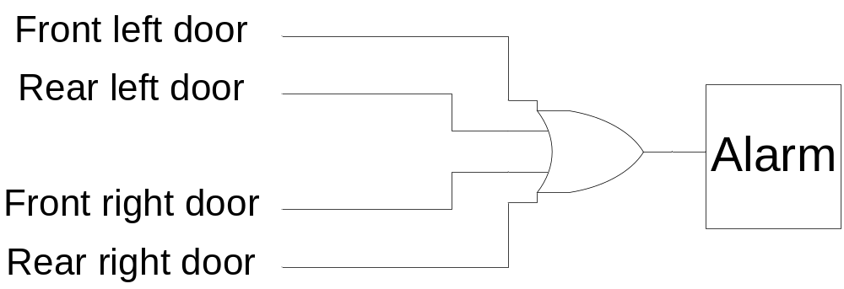
OR Gate Applications
Car door open alarm

Slide 16
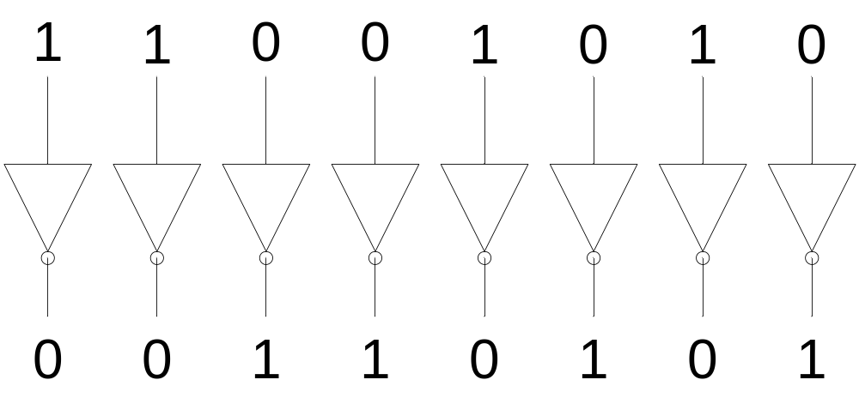
NOT Gate Applications
1’s Complement

Slide 17
Alternate Representations

Slide 18
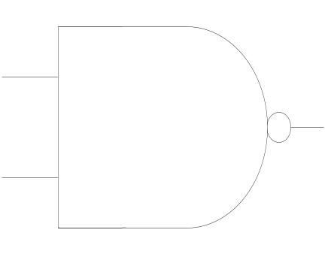
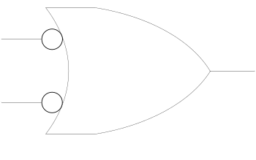
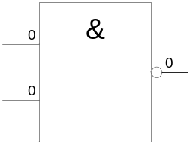
NAND Gate
1 output
2 inputs
3 inputs
4 inputs
Multiple inputs

Slide 19
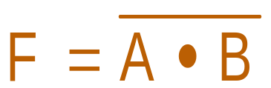
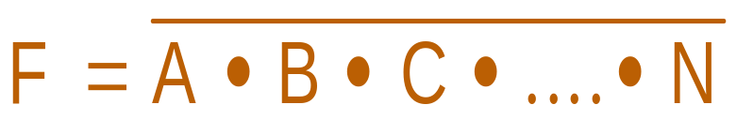
NAND Gate function
NOT-AND function
Input |  | Output
A | B | F
0 | 0 | 1
0 | 1 | 1
1 | 0 | 1
1 | 1 | 0

Slide 20
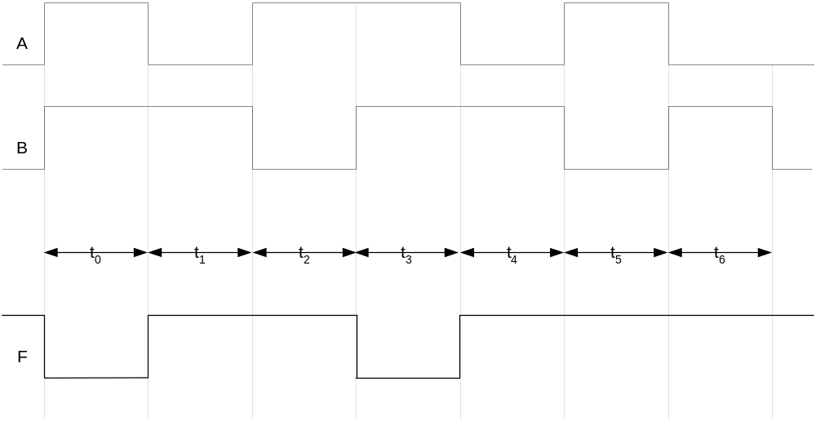
NAND Gate Timing Diagram

Slide 21
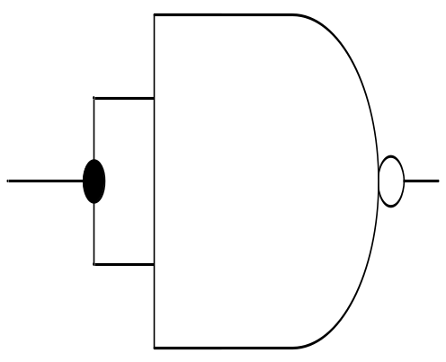
NAND Universal Gate
Input |  | Output
A | B | F
0 | 0 | 1
0 | 1 | 1
1 | 0 | 1
1 | 1 | 0

Slide 22
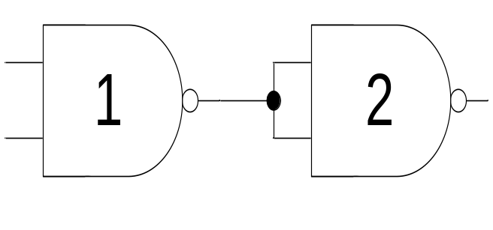
NAND Universal Gate
Input |  | Output | Output
A | B | F1 | F
0 | 0 | 1 | 0
0 | 1 | 1 | 0
1 | 0 | 1 | 0
1 | 1 | 0 | 1

Slide 23
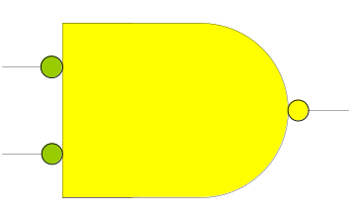
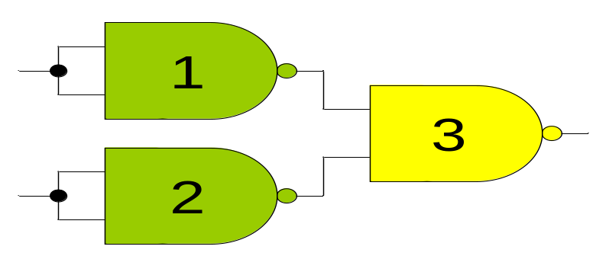
NAND Universal Gate
Input |  | Output
A | B | F
0 | 0 | 0
0 | 1 | 1
1 | 0 | 1
1 | 1 | 1

Slide 24
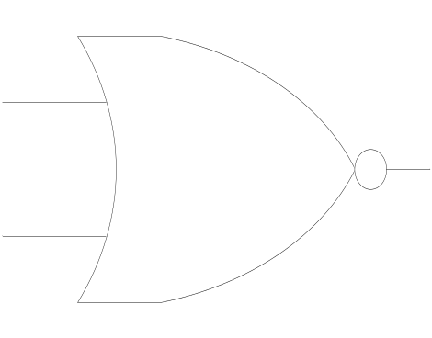
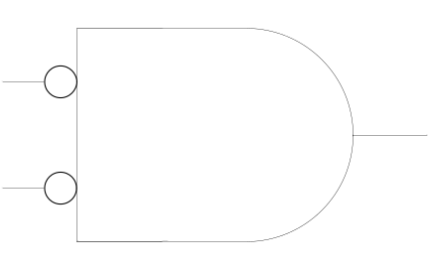
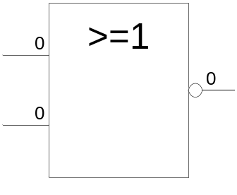
NOR Gate
1 output
2 inputs
3 inputs
4 inputs
Multiple inputs

Slide 25
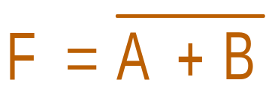
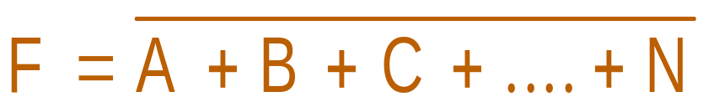
NOR Gate function
NOT-OR function
Input |  | Output
A | B | F
0 | 0 | 1
0 | 1 | 0
1 | 0 | 0
1 | 1 | 0

Slide 26
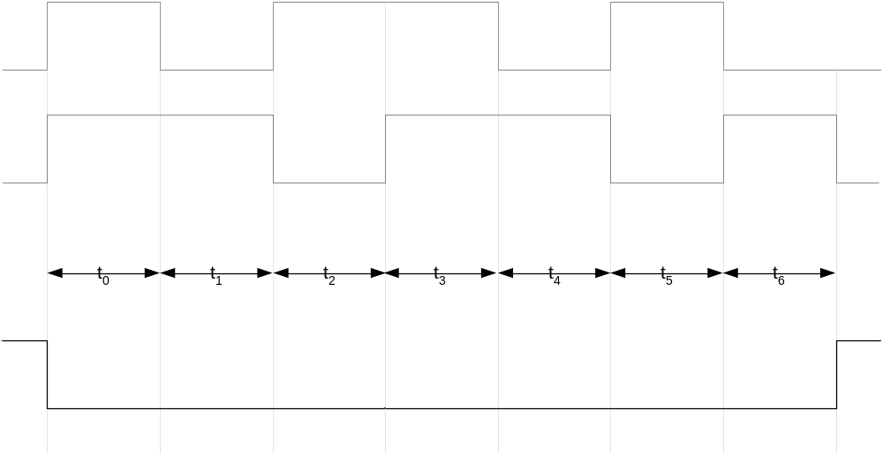
NOR Gate Timing Diagram

